Slide 1
Shandong NO.2 Machinery Co Ltd.
www.no2machinery.com
Address: No.1,Hunan Road, Hutian, Zhangdian District, Zibo, Shandong Province, China
TEL: (86)533-2070506/0086-13662624231
FAX: (86)533-2070501

Slide 2
Company Introduction
Our customers
Capacity
Catalogue
certificates
Applications
Main materials
MIM Process

Slide 3
1
Company Introduction

Slide 4
Shandong NO.2 Machinery Co., Ltd. is a MIM(metal injection molding) military factory started at 1965.
We have 350 employees, including 80 technicians, 60 senior engineers. Our factory covers an area of 108,000 square meters. The registed capital is 10millions RMB, total capital 100millions. We have more than 1200 sets of Injection machines, sintering furnaces, degreasing machines, CNC lathes, Multi-purpose Tool Machines and testing equipments. With constantly enhancing and improving factory management, we have obtained various quality certificates including GBT/T 19001-2008/ISO 9001:2008, China Arms Assembling Certificate, Grade II Physical and Chemical Detection of Weapon Industry, Grade III National Defence Metrology Organization etc..
Our MIM technology reach the leading level in China. Our parts are used in autos, motor cycles, electric tools, military arms etc..
We focus high attention on talents scientific researching. In terms of elites and technology, we widely recruit undergraduate bachelors and graduate masters who study in MIM and machinery major. In order to found technology base, we also cooperate tightly with China famous universities like Central South University, University of Science and Technology Beijing, Nanjing University of Science and Technology and Shandong University of Science and Technology etc..
Company Introduction I

Slide 5
In the aspect of hardware, we have our own material feeding proprietary intellectual property right, professional design and tools making abilities. Regarding to equipments, we imported SHIMADZU integrated vacuum sintering furnaces from Japan, using German BASF catalytic debinding production techonology. Moreover, we have CNC lathes, heat treatment furnaces, magnetic grinding machines, carbon sulfur analyzers, flaw detectors, density analyzers etc.. We can ensure every machinery performance requirements.
Based on our strong researching and production ability, we are confident to be your reliable and priority choice supplier in MIM. Welcome to visit our factory!
Company Introduction II

Slide 6
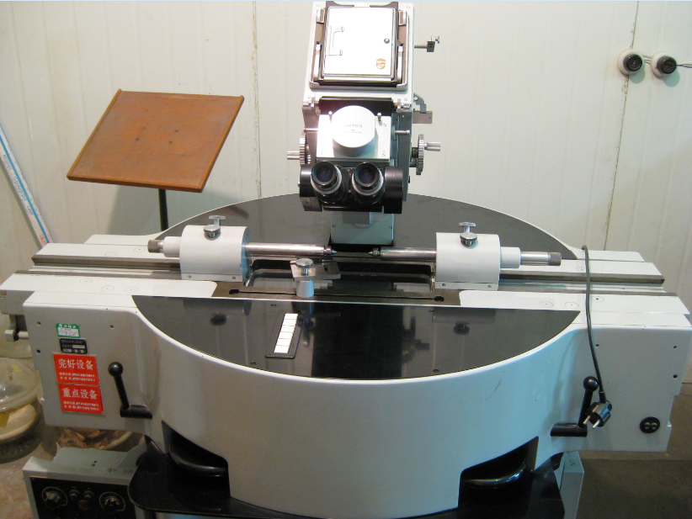
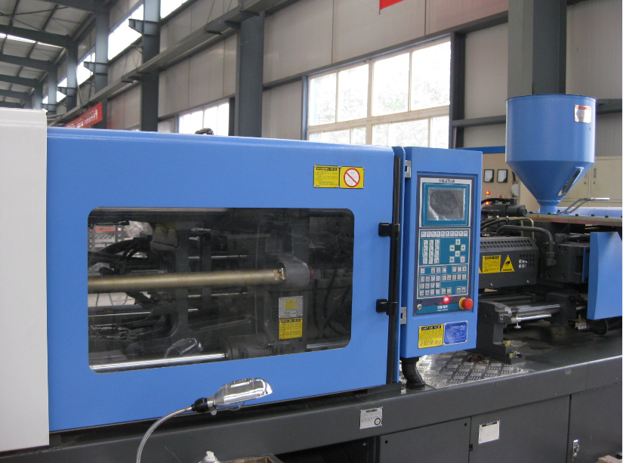
2
Capacity

Slide 7
Equipments
Our advantages
Capacity
Exllent technology
Quality control

Slide 8
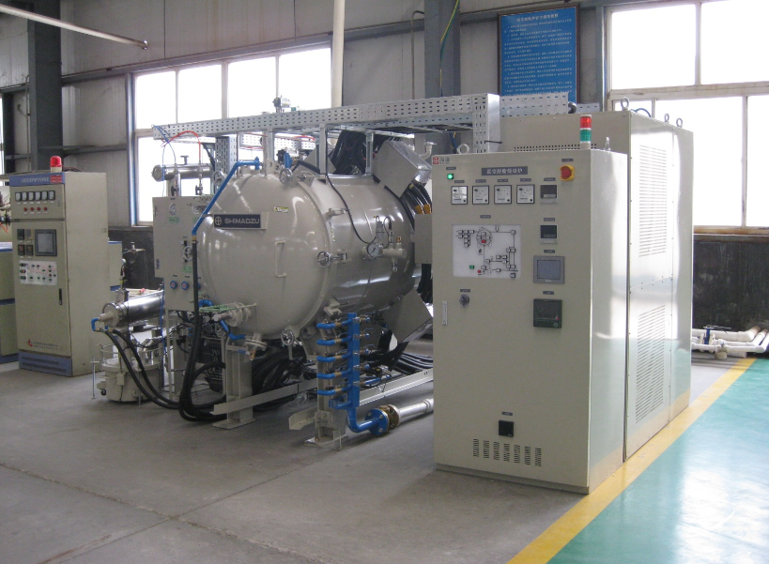
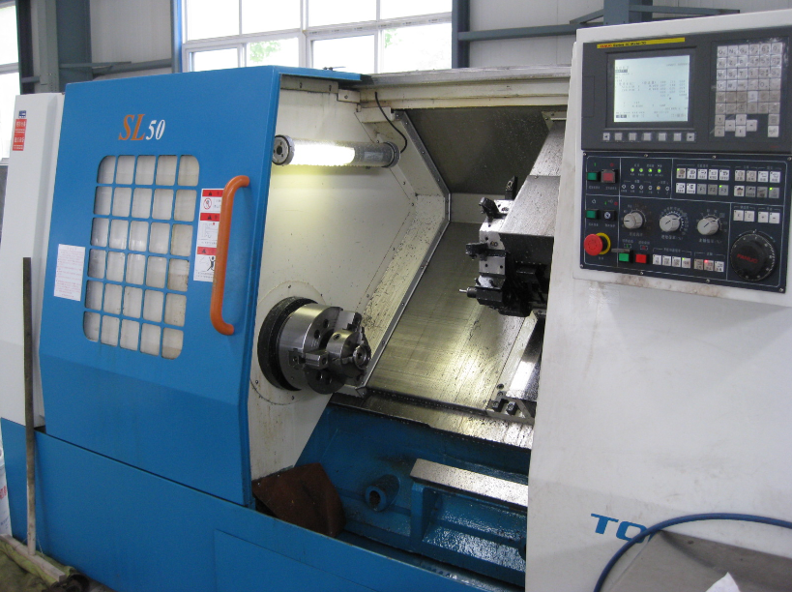
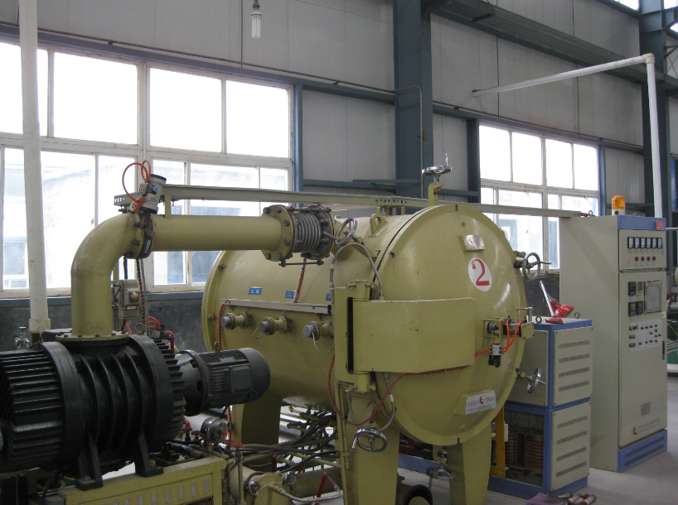
We have more than 1200sets of Injection machines, sintering furnaces, degreasing machines, CNC lathes, Multi-purpose Tool Machines and testing equipments,heat treatment furnaces, magnetic grinding machines, carbon sulfur analyzers, flaw detectors, density analyzers etc.. We can ensure every machinery performance requirements.

Slide 9
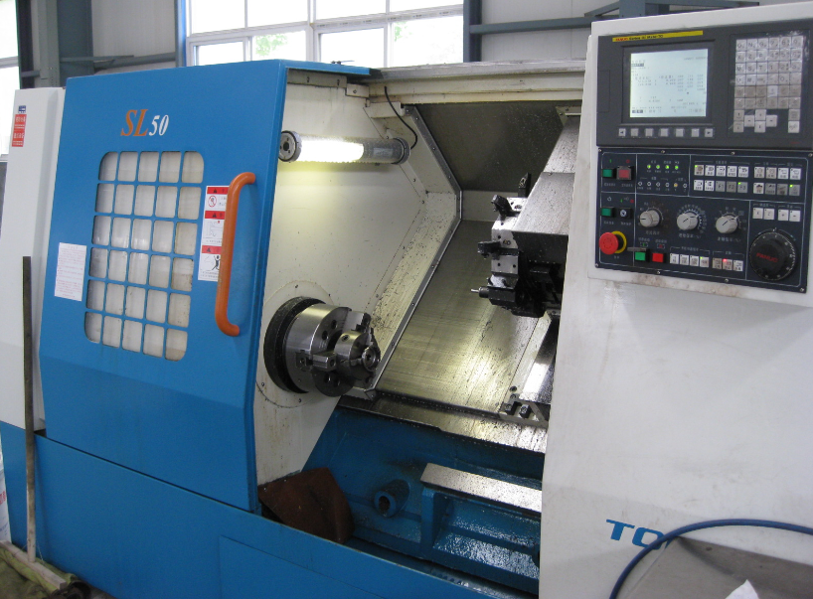
Our advantages
We feed material with our own feeding systems. Our material cost is usually 2 times higher than normal factories, but our parts quality is more stable.
Be sides, we have obtained several quality certificates, some of which are even higher standard than ISO 9001.
Unlike other factories, we have own CNC lathes and heat treatment furnaces, which ensure parts quality more controllable.

Slide 10
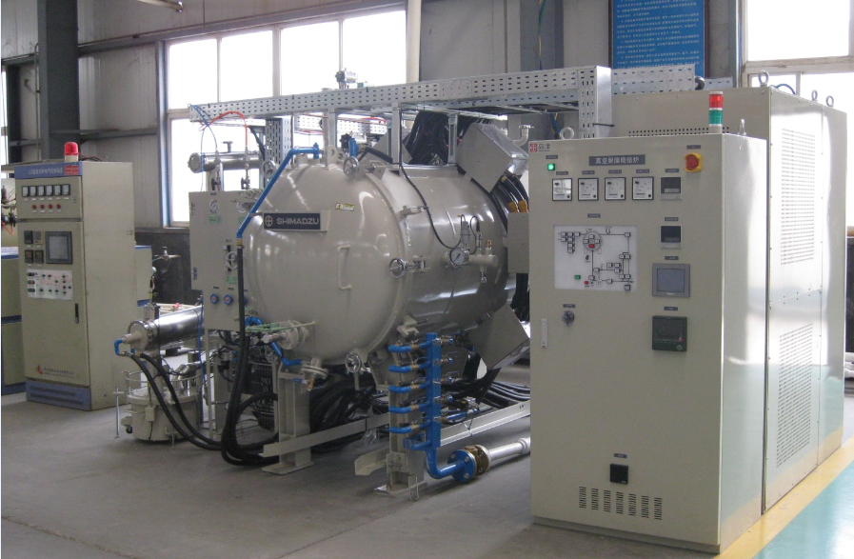
SHIMADZU integrated vacuum sintering furnaces

Slide 11
We have own material feeding proprietary intellectual property right, professional design and tools making abilities. Regarding to equipments, we imported SHIMADZU integrated vacuum sintering furnaces from Japan, using German BASF catalytic debinding production techonology..
Exllent technology

Slide 12
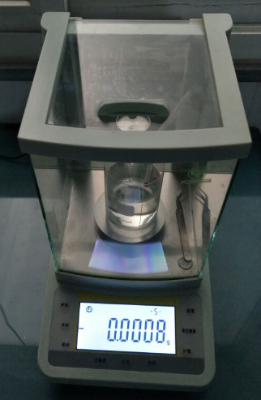
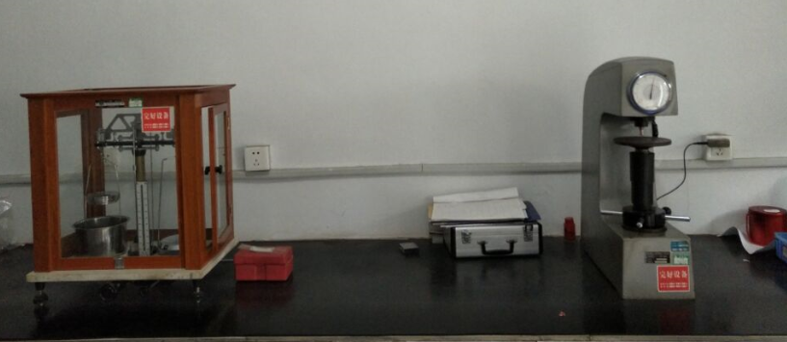
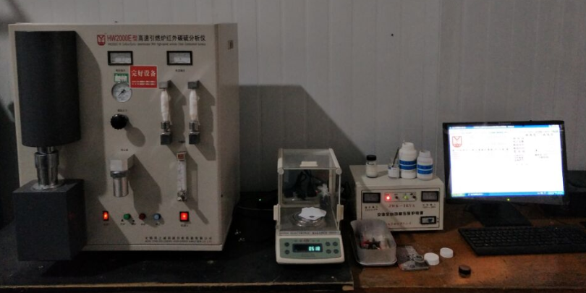
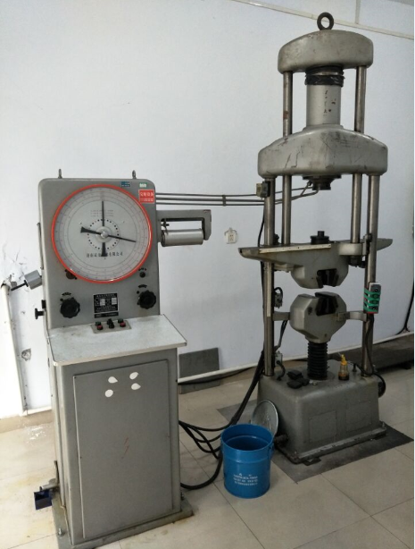
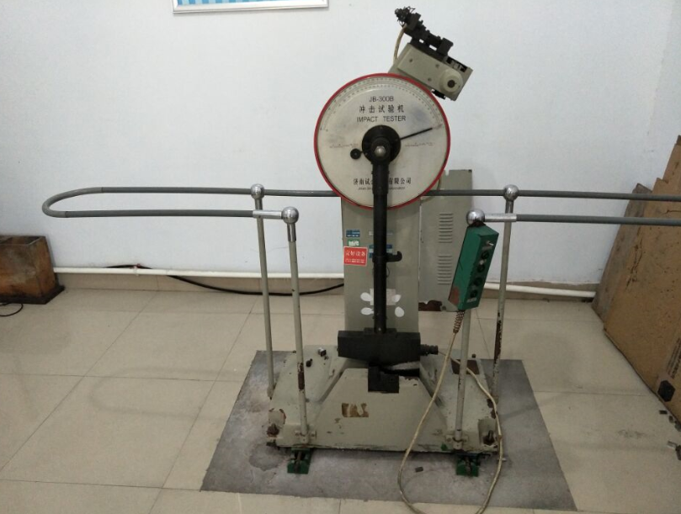
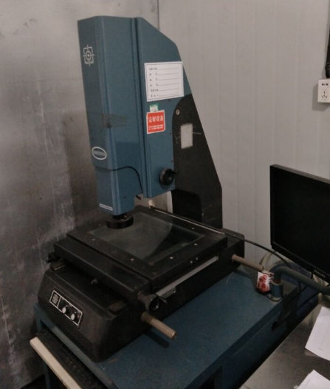
Quality control
We have series kinds of testing equipments to ensure the quality control.

Slide 13
3
Applications

Slide 14
Firearms
Electric/handle tools
Auto
Electrical equipments
MIM parts applications
Advanced locks
Medical equipments
Other complex shape parts

Slide 15
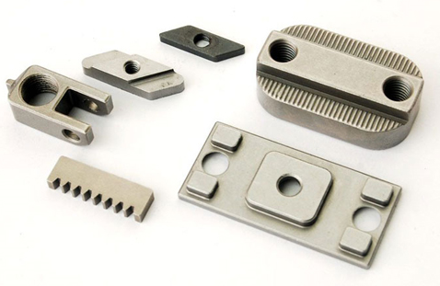
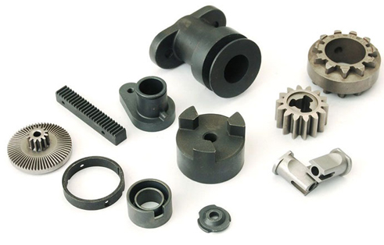
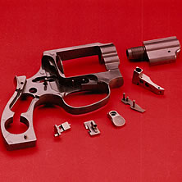
4
MIM process

Slide 16
MIM Process
Step1
Step 2
Step 3
Step 4
Step 5
Raw
material
mixing
Injection
shaping
Sintering
Binder Removing
Reshaping and post machinig

Slide 17
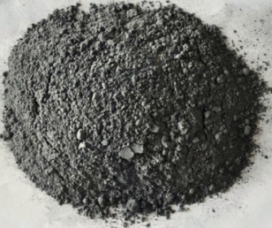
5
MIM material

Slide 18
Iron MIM 4605
Fe4Ni/Fe8Ni
MIM main
material
Steel 4140
SUS 316/316L
SUS 304
SUS 440C

Slide 19
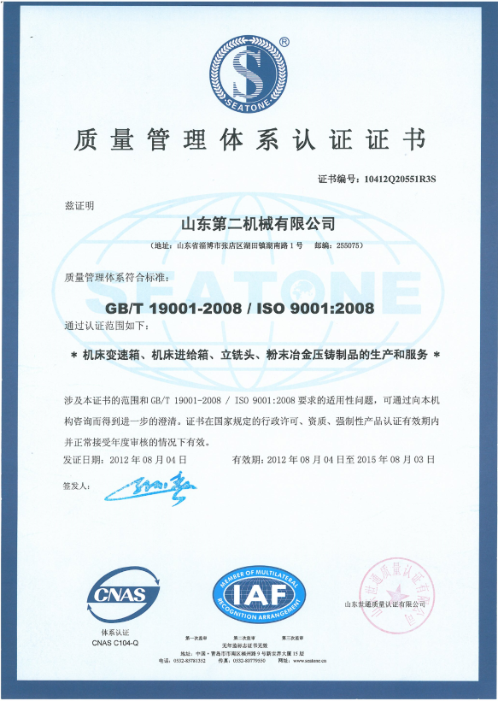
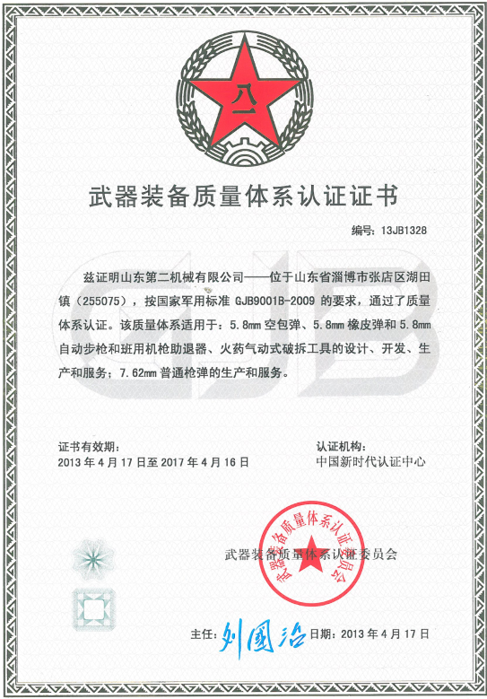
6
Certificate

Slide 20
Parts of our customers
7

Slide 21
THANK YOU！
Shandong NO.2 Machinery Co Ltd.
www.no2machinery.com
Address: No.1,Hunan Road, Hutian, Zhangdian District, Zibo, Shandong Province, China
Email:sales@no2machinery.com
TEL: (86)533-2070506/0086-13662624231
FAX: (86)533-2070501

